Slide 1
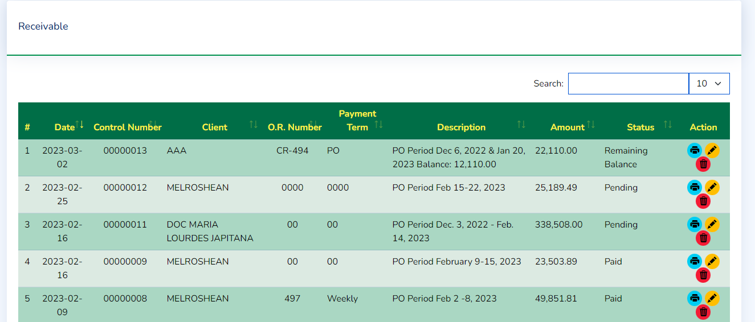
Amount will be change to Total Due
Add next to Total Due the Remaining Balance
Status remove the Remaining Balance

Slide 2
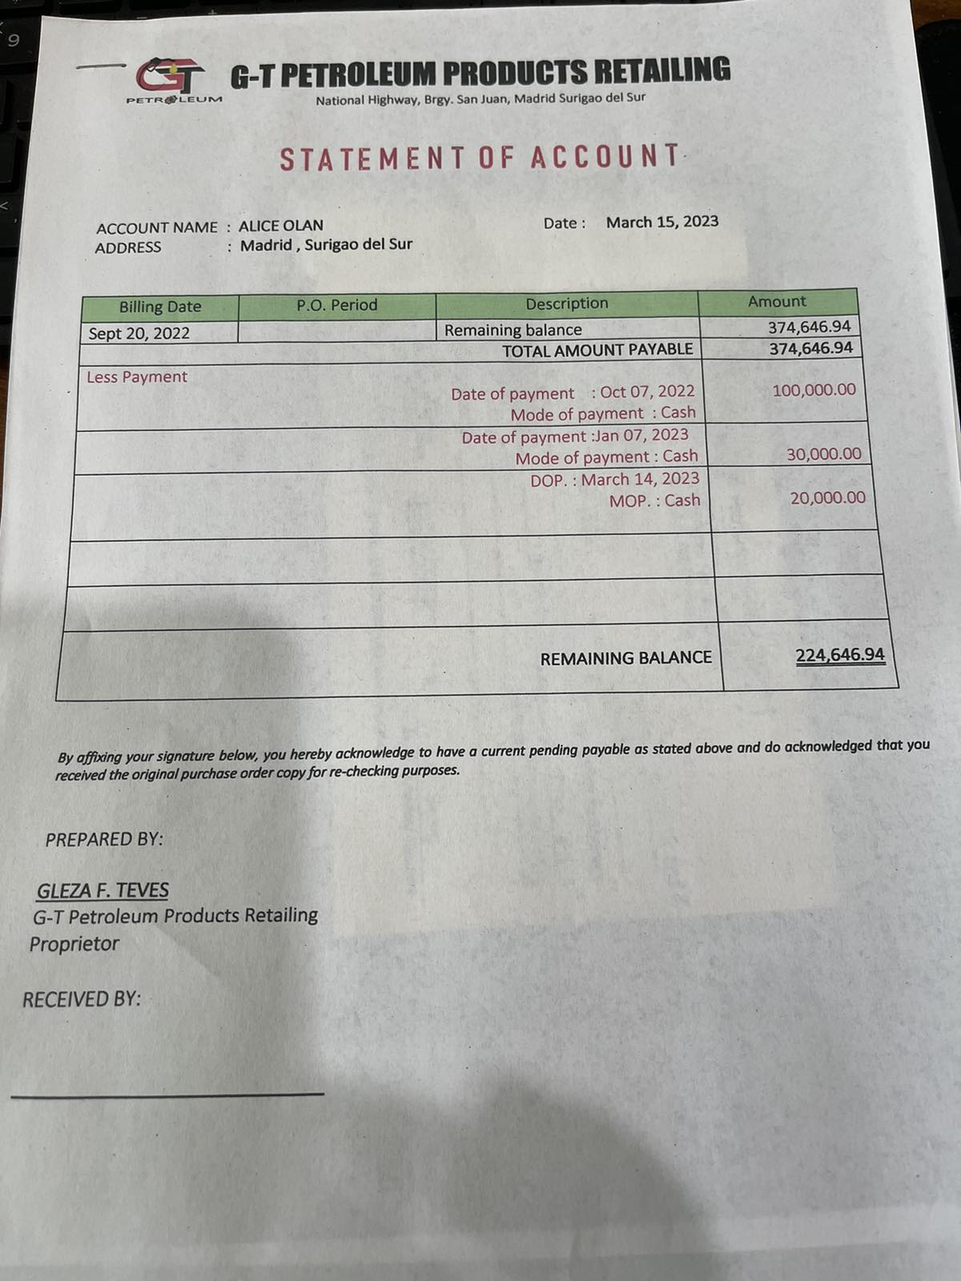
Statement of Account
S
Input : Date of Payment
Mode of Payment
Payment Reference
Amount
STATEMENT
Must be in a new table receivable_payment_table.
Remaining balance will be updated on every entry or deletion.
By Affixing your signature below, you hereby acknowledge to have a current pending payable as stated and do acknowledge that you received the original purchase order copy for re-checking purposes.
G-T Petroleum Products Retailing Proprietor

Slide 3
Remove Purchase order from ordinary user(Done 04/20/2023)
Sales order only visible within the day to ordinary user(Done 04/20/2023)

Slide 4
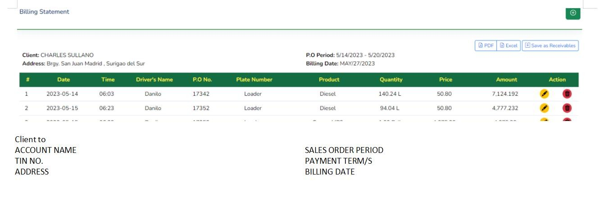
*****Payment terms makikita lang after ma save as receivables

Slide 5
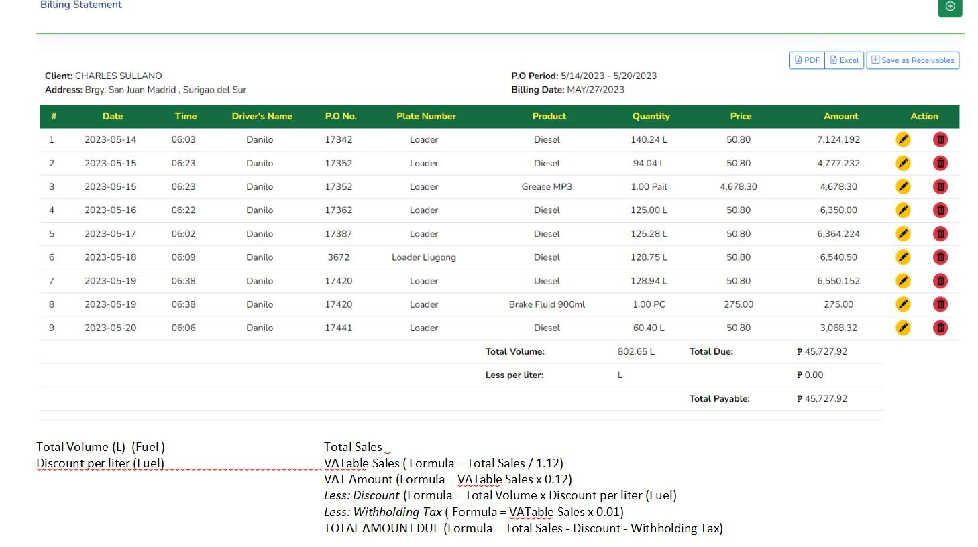

Slide 6
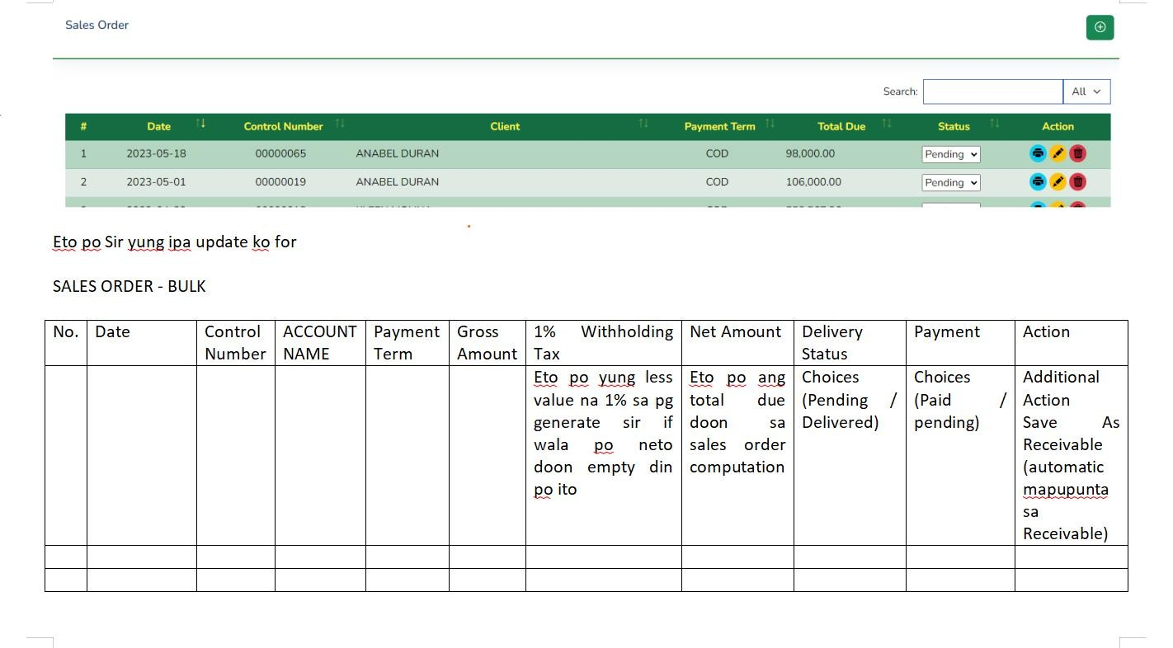
Pending on Additional option to transfer to Receivable

Slide 7
